Slide 1

Gesture Based UI Project
Bowling Bonanza
Jeremy Yon
Daire Ní Chatháin

Slide 2

Project Overview
Recreate Classic Game
Unity Game Engine → C#
Myo Band
Menu navigation & control gameplay
Notes:
Route of recreating bowling game
Game chose → bowling

Slide 3
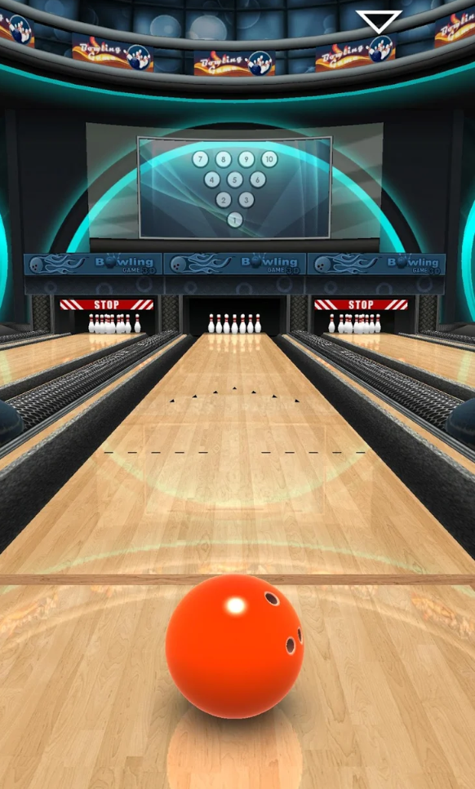
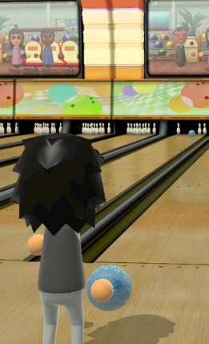
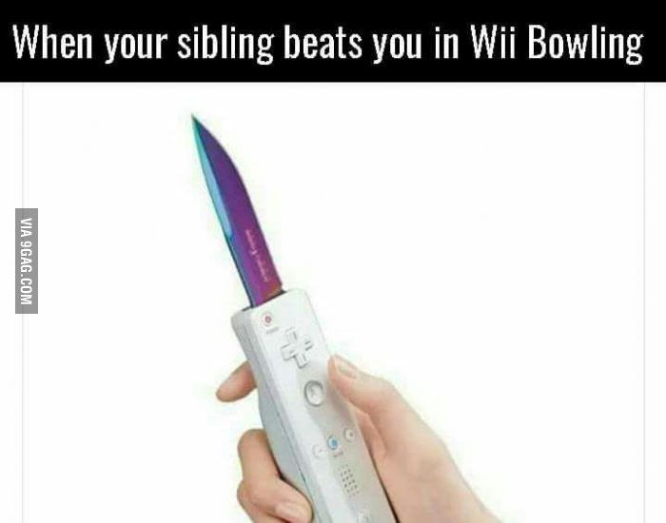
Research Phase
Bowling 3D
Wii Sports Bowling
Popular Bowling Games
Various Platforms
mobile/gaming console/pc
What makes them successful
How they effectively use gestures
Notes:
To begin projects we conducted research phase
Involved → Looked into other bowling games
→ different platforms (mobile/gaming console/pc)
→ what makes them successful/ addictive
→ How they effectively use gestures
One thing we noted..common both key
Natural feeling ux
Instincively know what to do gestures effective
How they caputred bowling action
Tried to take that incorporate

Slide 4
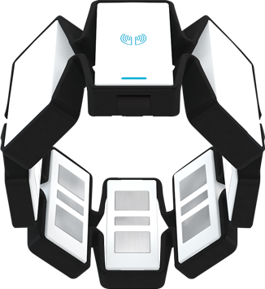
Gestures
Research complete
Key Gestures Identified
Mimic hand throwing bowling ball
Myo → Ideal Hardware
Spatial Data
Orientation Data → rotation
Acceleration Data → speed
Notes:
After research phase identified key gestures needed
Mimic hand throwing bowling ball
Emulate movement
Myo band ideal piece of hw to capture this action needed → seamless
Use its spatial data gathererd to control gdata me play
Orientation data → get rotation/which way hand is positioned
Acceleration Vector → get speed of hand’s movement

Slide 5
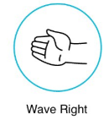
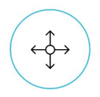
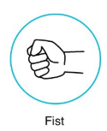
Gestures
Calibrate & Sync MYO
Get Spin & Acceleration
for roll
Lock bowling ball direction
Notes:
HOW APPLIES TO MYO RATIONALE
SPIN E T
Gesture incorporated into out application

Slide 6
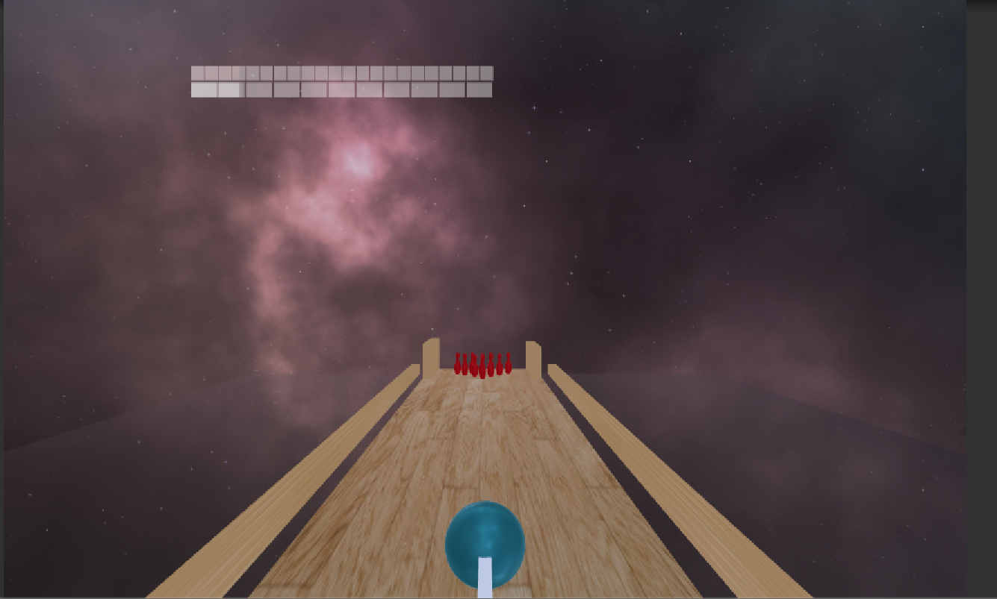

Slide 7
Code Breakdown
Myo pose capture
Myo axis capture
Calculate trajectory
Calculating scores
Resetting pins and ball

Slide 8
Issues
Accuracy of Myo Band
Values change every time its synced
Accidental trigger of different poses

Slide 9
DEMO

Slide 10

Conclusion & Future Development
Gesture based menu system
Update UI Elements
Fine tune MYO data
Code Cleanup

